Slide 1

Hands on with Microsoft Azure
Sean McKenna (@seanmckmsft)
Ralph Squillace (@ralph_squillace)
Cory Fowler (@cfowlermsft)

Slide 2
Why are we here?

Slide 3
Because hell has frozen over.

Slide 4
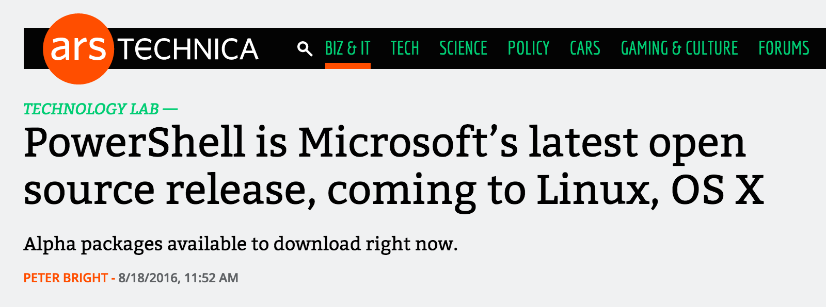
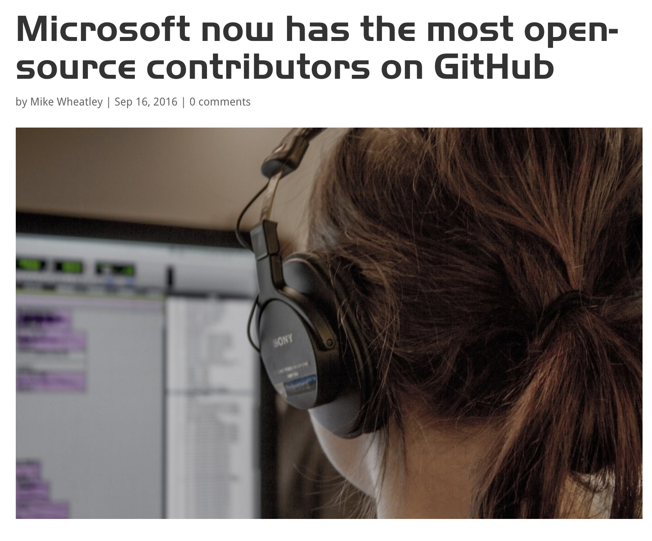
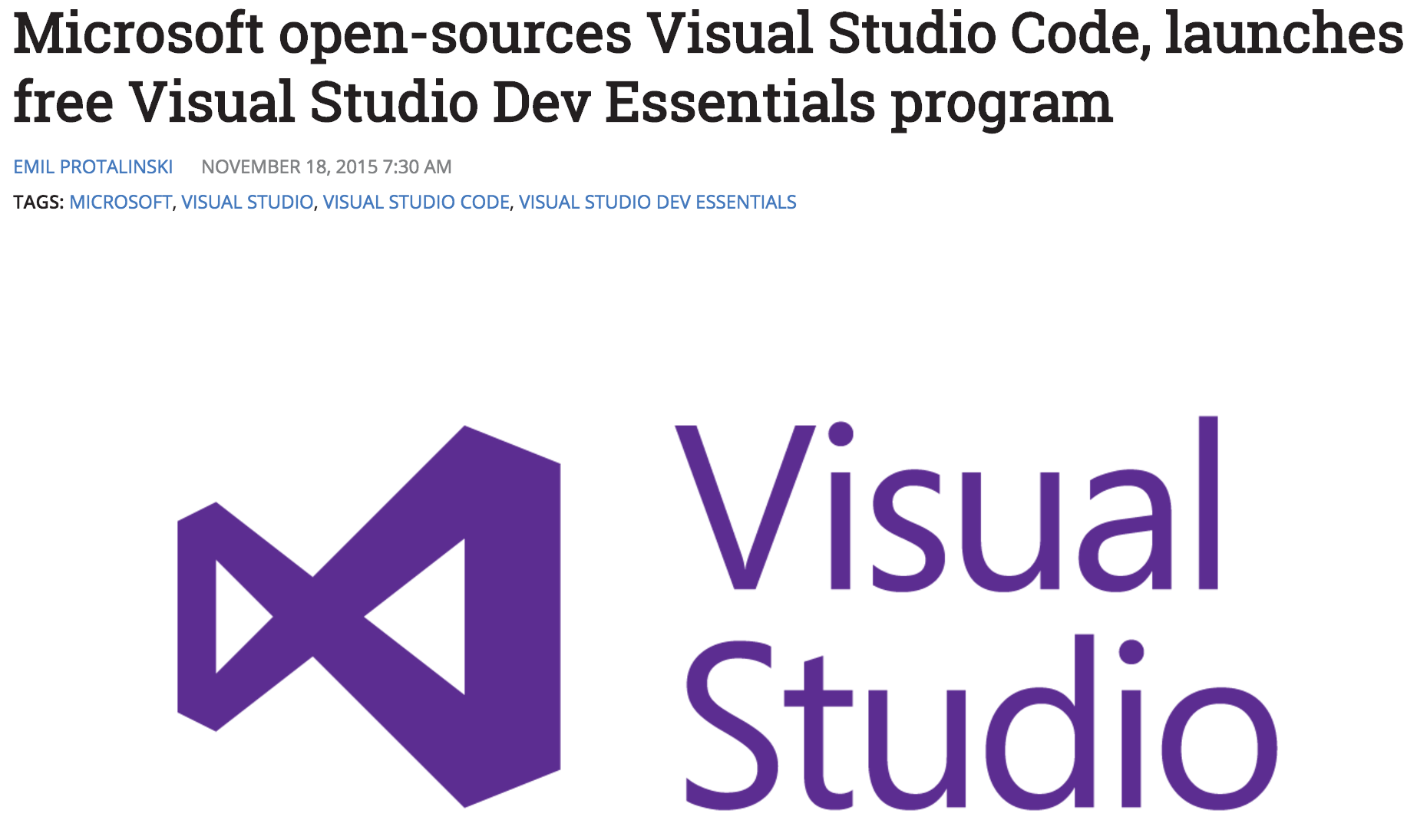
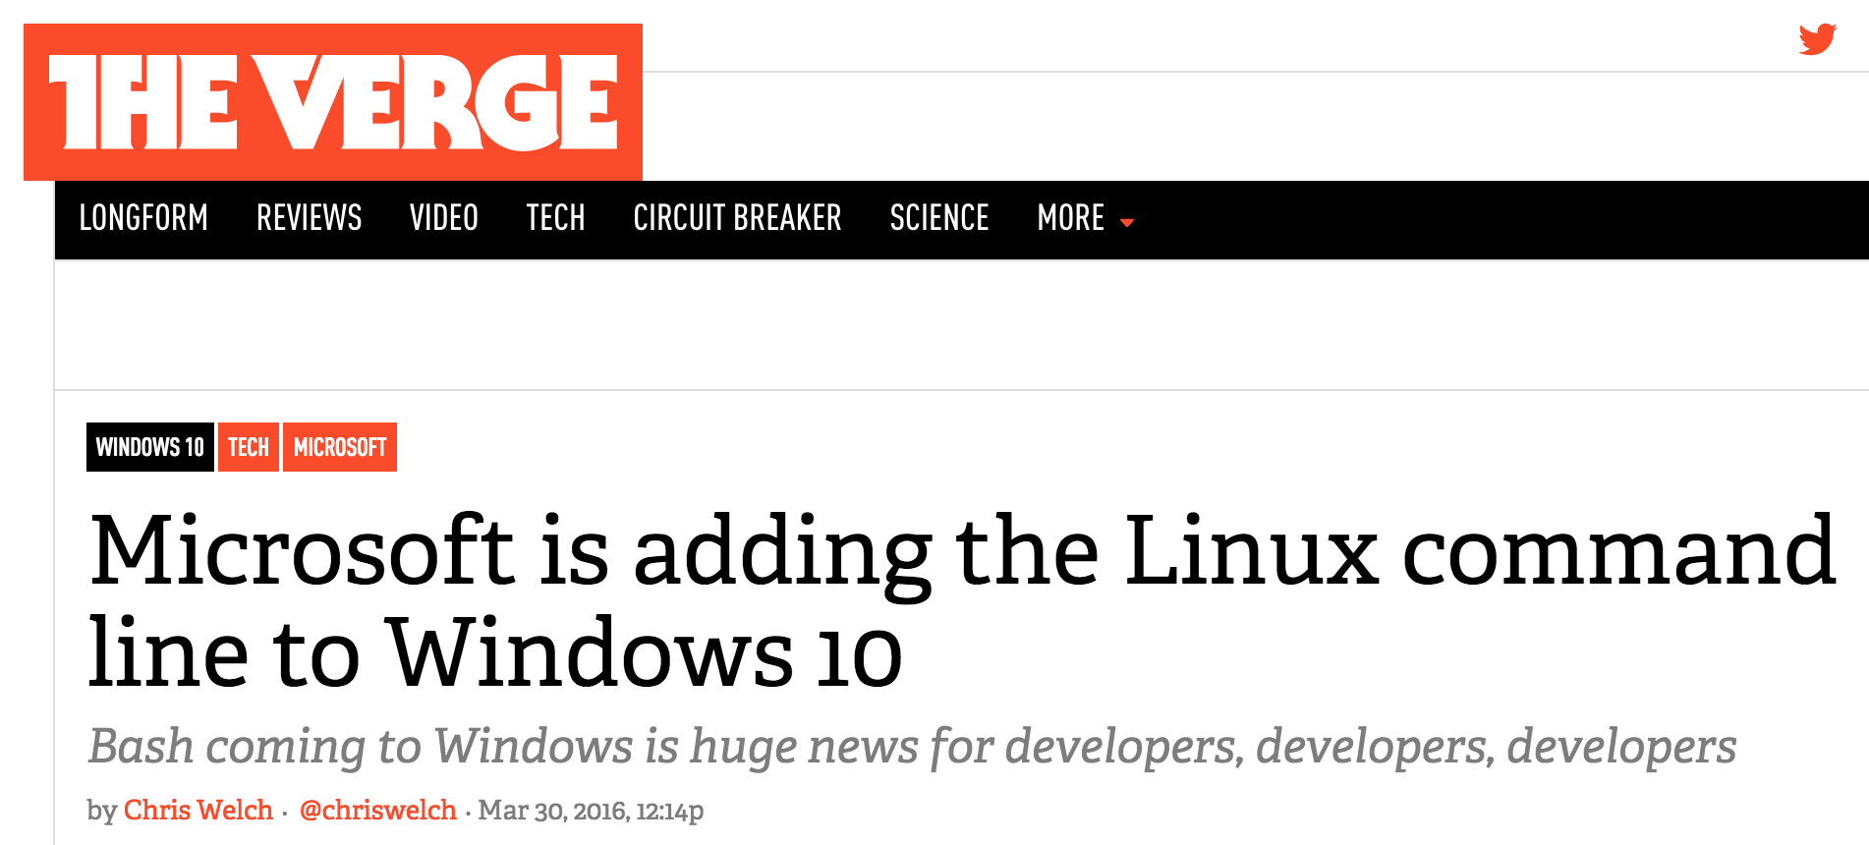

Slide 5
And yet…

Slide 6
Common developer perception:
Azure == Windows + .NET + Visual Studio

Slide 7
Reality:
Azure is the best cloud for Windows workloads and .NET developers.

Slide 8
But it is so much more.

Slide 9
We’re here to introduce you to the modern Azure.

Slide 10

34
Hyper-scale footprint
Azure regions
Notes:
Canada: First to market
USA: FedRamp, DISA, HIPAA, CJIS, ITAR, GBI addendums
Germany: Data Soverignty
China: Legal opportunity multi-national cloud

Slide 11
The amount of servers added in 2011
we add every day
34
Azure regions around the world
Hyper-scale footprint
More than AWS and Google Cloud combined
Azure regions

Slide 12
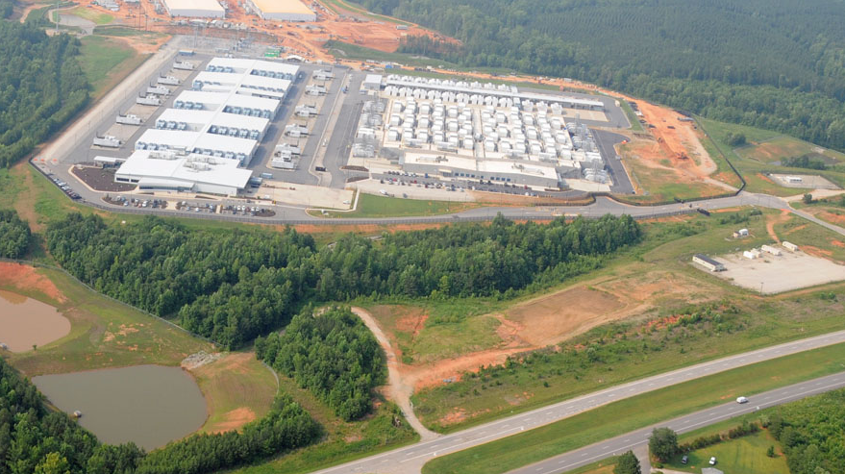
Notes:
This DCs are huge!!!!
That is me, coming to install the software.

Slide 13
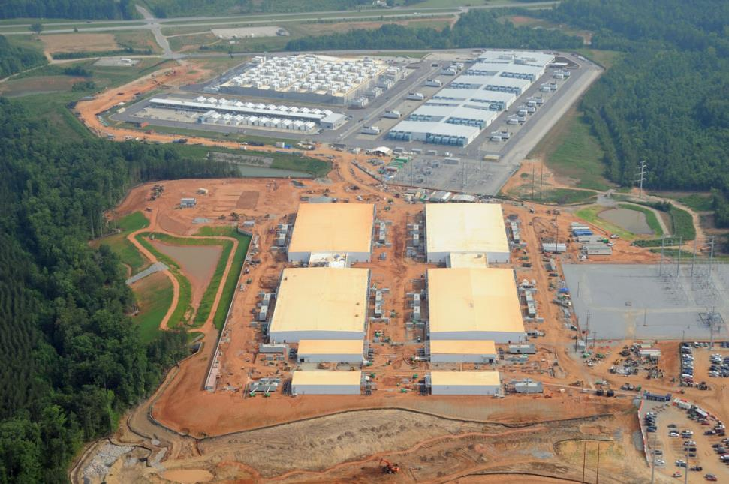
13

Slide 14
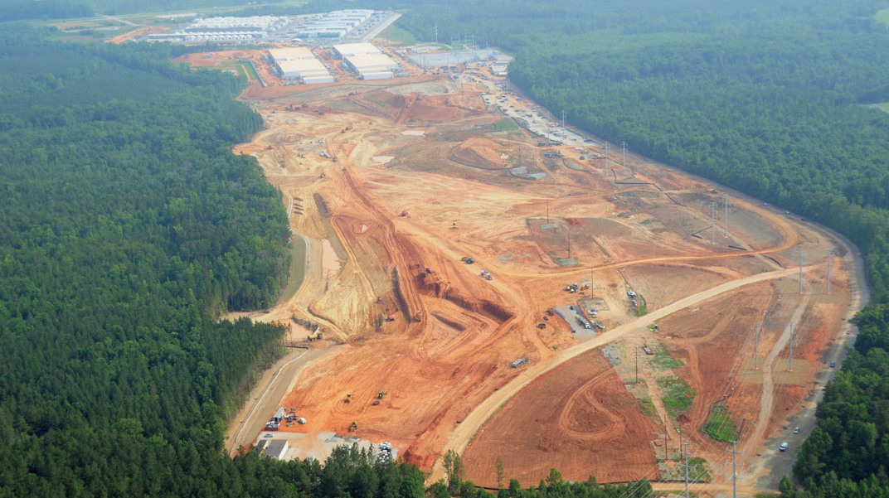

Slide 15
Notes:
Canada: First to market
USA: FedRamp, DISA, HIPAA, CJIS, ITAR, GBI addendums
Germany: Data Soverignty
China: Legal opportunity multi-national cloud

Slide 16








8
In-Country
Disaster Recovery
Notes:
Canada: First to market
USA: FedRamp, DISA, HIPAA, CJIS, ITAR, GBI addendums
Germany: Data Sovereignty
China: Legal opportunity multi-national cloud

Slide 17

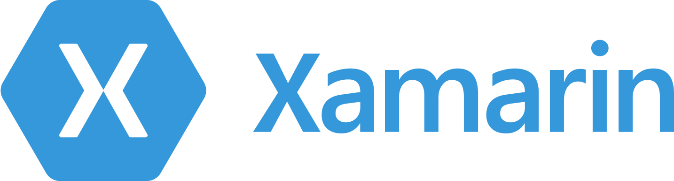





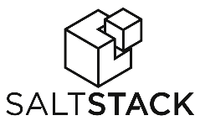












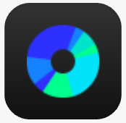





















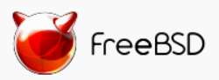

Any app, language, device or OS works with Azure
DevOps
Clients
Management
Applications
PaaS &
DevOps
App Frameworks
& Tools
Databases &
Middleware
Infrastructure

Slide 18









Linux/Open Momentum
>30% external VMs are Linux
>50% of new VMs are Linux
60% of 3rd-party IaaS are Linux
55% of GitHub templates are Linux
(Ansible, Apache, Bitcore, Dokku, Kafka, Jenkins, Postgres, Redis, Scrapy, Spark, HAProxy…)

Slide 19













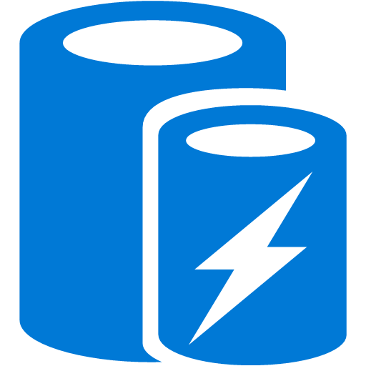










































Platform Services
Security & Management
Services Compute
Web and Mobile
Data
Hybrid
Operations
Cloud
Services
Service
Fabric
Web Apps
API Apps
Portal
SQL
Database
Data
Warehouse
DocumentDB
Azure AD
Health Monitoring
Batch
RemoteApp
Azure Active
Directory
Mobile
Apps
Logic Apps
AD Privileged
Identity
Management
Redis
Cache
Azure
Search
Storage
Tables
Azure AD
B2C
API
Management
Notification
Hubs
Integration
Domain Services
Multi-Factor
Authentication
Analytics & IoT
Storage
Queues
BizTalk
Services
Functions
Backup
Automation
Hybrid
Connections
Service Bus
Developer Services
HDInsight
Machine
Learning
Stream
Analytics
Data
Lake
Operational
Analytics
Scheduler
Key Vault
Visual Studio
Azure
SDK
Data
Factory
Event
Hubs
Data
Catalog
Import/Export
Media & CDN
Store/
Marketplace
Media Services
Content Delivery
Network (CDN)
VSTS
App
Insights
Mobile
Engagement
Azure Site
Recovery
IoT Hub
VM Image Gallery
& VM Depot
StorSimple
Infrastructure Services
OS/Server Compute
Storage
Networking
Virtual Machines
Container
Service
BLOB Storage
Azure
Files
Premium
Storage
Virtual Network
Load Balancer
DNS
Express
Route
Traffic Manager
VPN Gateway
App
Gateway
Datacenter Infrastructure (34 Regions, 30 Online)

Slide 20
Plan for today

Slide 21
Goals
Walk through the core Azure compute offerings
App Service
Functions
Container Service
Service Fabric
Demonstrate usage of an unmanaged 3rd party platform on Azure with Kubernetes
Get hands-on building and deploying apps

Slide 22
Schedule
Topic/Activity | Time
Intro | 9:00-9:30
App Services and Functions | 9:30-10:15
Azure Container Service | 10:15-10:45
BREAK | 10:45-11
Kubernetes on Azure | 11-11:30
Service Fabric | 11:30-12:15
LUNCH | 12-1
Hands-on/other deep-dive sessions | 1-3:30
Wrap-up | 3:30-4

Slide 23
Wrap-up

Slide 24
Resources
Azure Developer Guide
https://azure.microsoft.com/en-us/campaigns/developer-guide/
Azure Samples
https://azure.microsoft.com/en-us/documentation/samples/
Azure Resource Manager Quickstart Templates
https://azure.microsoft.com/en-us/documentation/templates/
Comparing Azure and AWS
https://azure.microsoft.com/en-us/campaigns/azure-vs-aws/
Solution architectures
https://azure.microsoft.com/en-us/solutions/architecture/

Slide 25
Trying things out
tryappservice.azure.com
Create and deploy an app for free for 24 hours
No credit card required
App service free tier
Deploy small apps for free indefinitely
Azure subscription and credit card required
Trial credits
$200 towards usage of any Azure services to start your subscription

Slide 26
AWS-to-Azure Dictionary
AWS Product/Term | Azure Equivalent
EC2 | Virtual Machines
S3 | Blob Store
Elastic File System | File Store
Virtual Private Cloud (VPC) | Virtual Network (Vnet)
Direct Connect | Express Route
RDS | Azure SQL
DynamoDB | DocumentDB
Auto-scaling Groups | VM Scale Sets
Kinesis | Event Hubs
CloudFormation | Azure Resource Manager (ARM)

Slide 27
BizSpark
Microsoft program for enabling new startups
3 years of free access to Microsoft tools and software, along with $750/month in Azure credit
Opportunity for up to $120k of free Azure credit as part of BizSpark Plus
Company requirements
<5 years old
Privately held
<$1m in annual revenue
http://bizspark.microsoft.com

Slide 28
Thank you!

